Slide 1
Exam Prep 70-533 Implementing Microsoft Azure Infrastructure Solutions
Ashok Kumar Jayabalan

Slide 2
Certification
4 Key links
aka.ms/70-533
aka.ms/certification/70-533
aka.ms/Azure/Shortcuts
aka.ms/Azure/IaaSOpsGuide

Slide 3
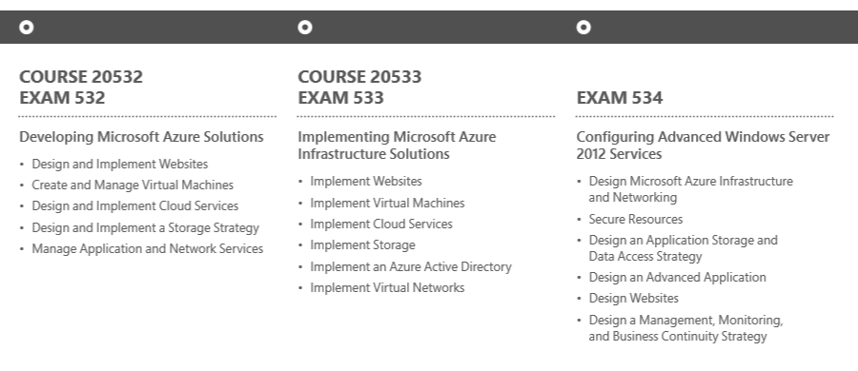

Roadmap – Azure Certification

Slide 4
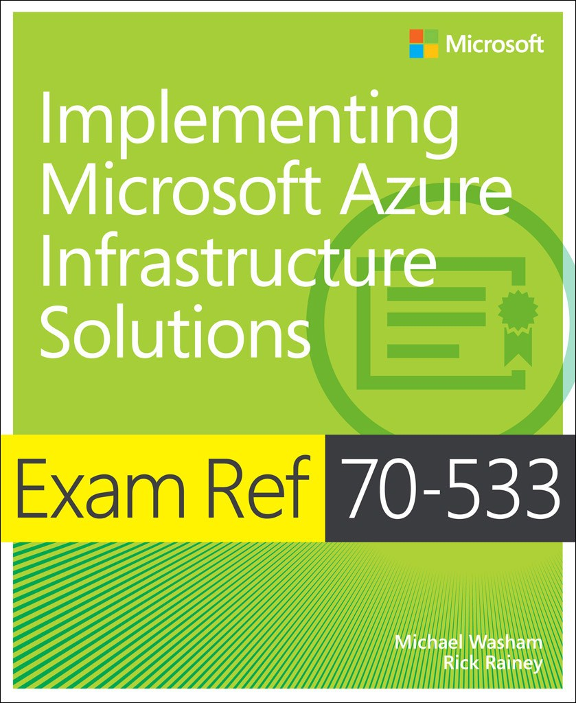
Study Resources, Tools and Testing
Study Resources
This slide deck – great study guide
5 Things to know at the end of each section
Embedded links for additional info / section
The MS Press Study Guide for 70-533
Azure Documentation
– Microsoft Azure
Go do it
Azure Subscription (MSDN, etc.)
Azure PowerShell
Azure CLI
Install & configure Azure CLI/ PowerShell
Practice Exams
Measure Up practice exams
Certification Exams

Slide 5
How to prepare and take the Exam
What to buy or use to study with
Almost everything written that you need can be found at azure.microsoft.com
Caveat Emptor! Anything not in the exam 70-533 exam objectives, future “previews”, or really old (ASM)
Get a Free trial account.
Ignite Hands-On Workshops/Labs
Microsoft Virtual Academy (MVA)
When doing a Prep Exam
Select all of the questions for a particular topic, then click END. Review all the answers right and wrong
Before you Press Start
Have a mental cheat sheet
Right before you start – DUMP IT on the paper they give you for notes

Slide 6
Let’s get ready!

Slide 7
70-533 Exam Objectives
Implement
Web Apps 15-20%
Virtual Machines 15-20%
Cloud Services 15-20%
Storage 15-20%
Azure Active Directory 15-20%
Virtual Networks 15-20%

Slide 8
Resource Groups
Definition
Containers to organize or add RBAC
Every resource *must* exist in one and only one resource group
Resource groups can span regions
Nesting not supported
ARM Templates
Desired State Deployment
Repeatable, consistent patterns
Parameterized JSON
READ THIS Aka.ms/Azure/ARM
RESSOURCE GROUP

Slide 9


Implement WebApps
Deploy
Configure
Diagnostics, Monitoring
Scale and Resilience
App Service Plans
aka.ms/Azure/WebApps

Slide 10
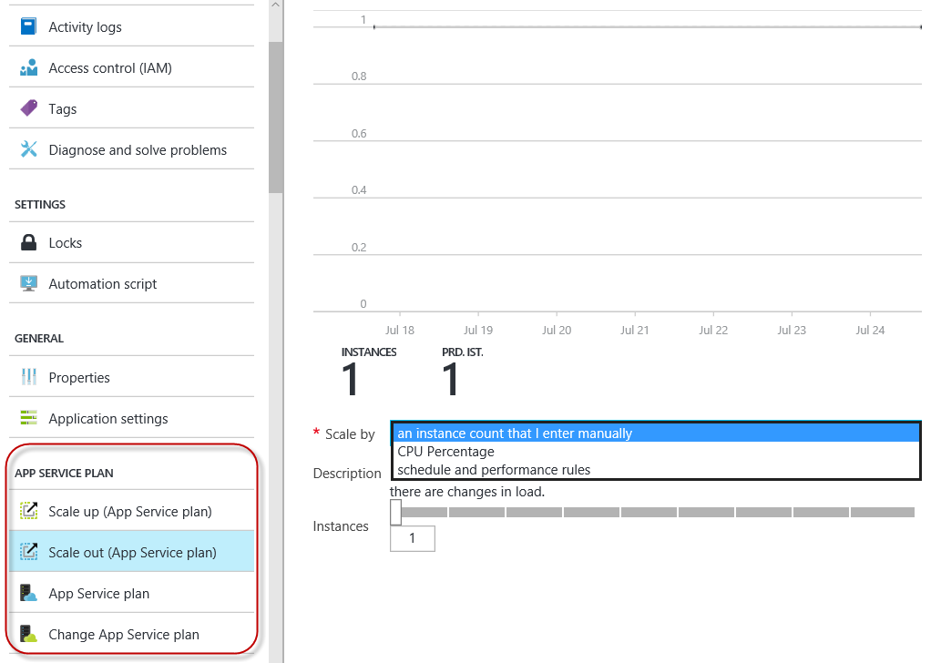
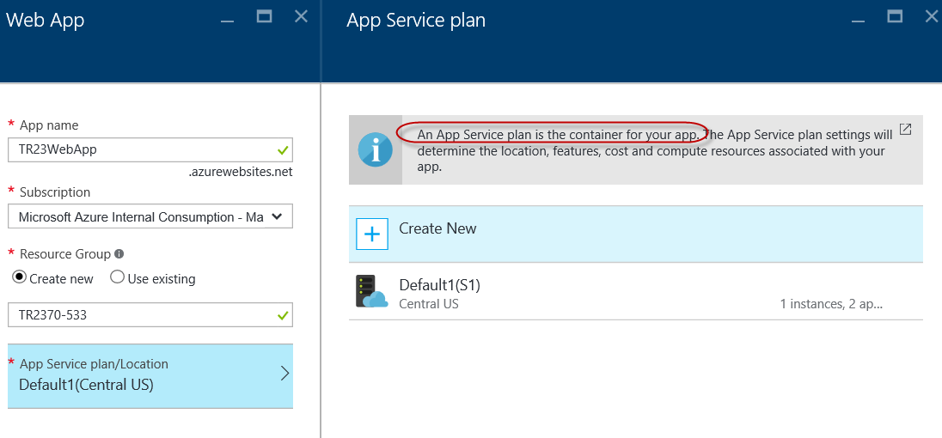
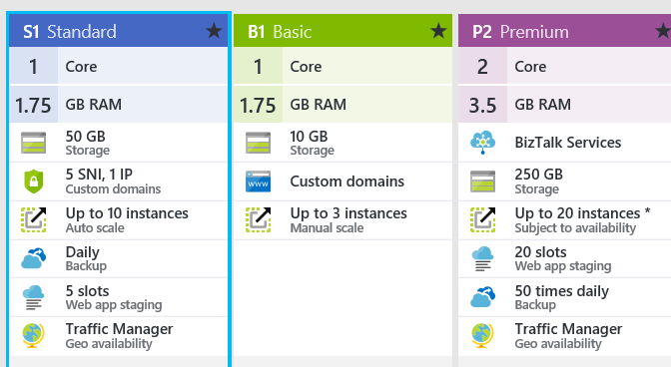
Deploy WebApps
App Service / ASE
PaaS Container
Run on managed VMs
Pricing Tiers
Free, Share, Standard, Basic, Premium
No Slots in Basic!
Scale Up, Scale Out
Can’t change Free until remove spending limits first!

Slide 11
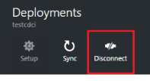
WebApps Deployment
Cloud Sync
Powered by Kudu Deployment Engine
Integrated with App Service
Select OneDrive (Apps\Azure Web Apps )or DropBox (Dropbox\Apps\Azure) as deployment source
Continuous Deployment
Continuous deployment workflow
BitBucket, GitHub, and Visual Studio Team Services (VSTS)
Best for integration of frequent/multiple contributions
Disable with Disconnect option in deployment

Slide 12
Local Git Deployment
Step 1 Create a local repository
Can use cmd program like GitBash, Bash (UNIX) or Terminal (OSX)
Intiialize it with git init
Step 2 Commit your content
If no repository content, create index.hml
Add the files to the repository git add -A
Commit the changes to the repository git commit -m "Hello Azure App Service“
Step 3 Enable Repository
If first time, need to setup deployment credentials Settings>Deployment>Credentials from the App’s blade
Step 4 Deploy Project
Click Settings>Properties for the Git URL. Use git remote to add the remote reference listed in Git URL. Push content with git push azure master

Slide 13
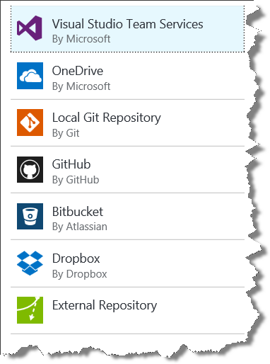
Deploy WebApps
Deployment Slots
Need Standard or Premium
Staging Environments
Swap Slots between environments
Auto Swap Option
With >1 slot, cannot change App Service Plan
Deployment Source
From cloud folder to Azure App Service
Use Kudu Deployment Engine
Web Jobs
Git or FTP
Username/Password for ALL subscriptions

Slide 14
Deployment Slots Swapped Settings
Settings that are swapped | Settings that are not swapped
General settings - such as framework version, 32/64-bit, Web sockets | Publishing endpoints
App settings (can be configured to stick to a slot) | Custom Domain Names
Connection strings (can be configured to stick to a slot | SSL certificates and bindings
Handler mappings | Scale settings
Monitoring and diagnostic settings | WebJobs schedulers
WebJobs content

Slide 15
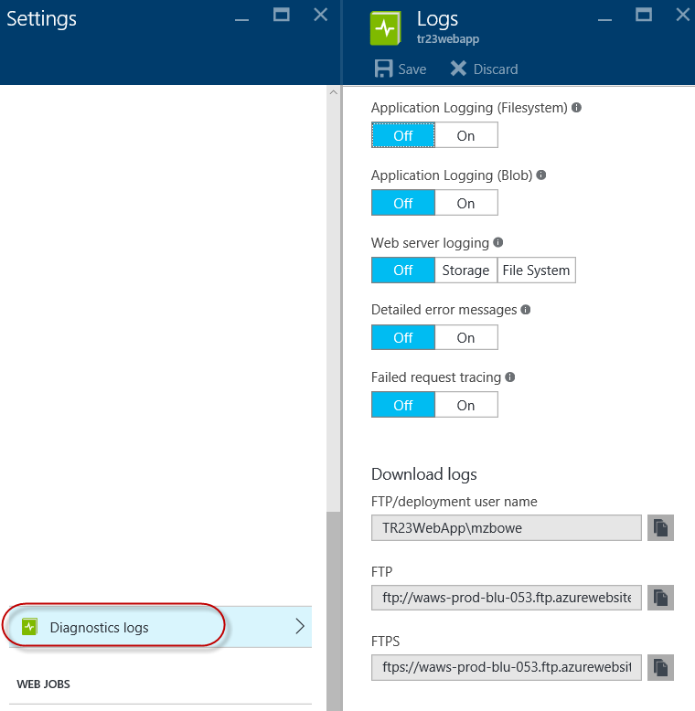
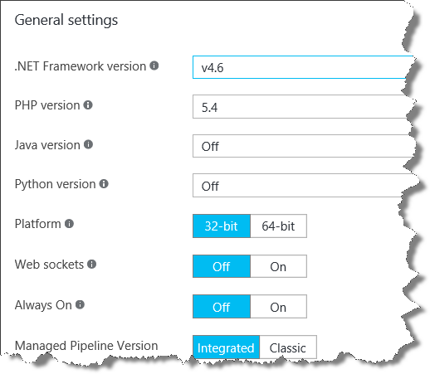
Configure WebApps
General Settings
Frameworks | .Net, .PHP, Java, Python | Enabling Java for app disables the others!
Free or Shared 32 Bit | Basic or Standard 64 Bit
In Basic/Standard can enable Always On
Auto Swap | updates to slot will push to Production
Diagnostic Logs
Application Logging (lasts 12 hours)
Web Server Logging (W3C extended log format)
Detailed Error Messages saved in /LogFiles/DetailedErrors
Failed Request Tracing (XML)
FTP download Logs

Slide 16
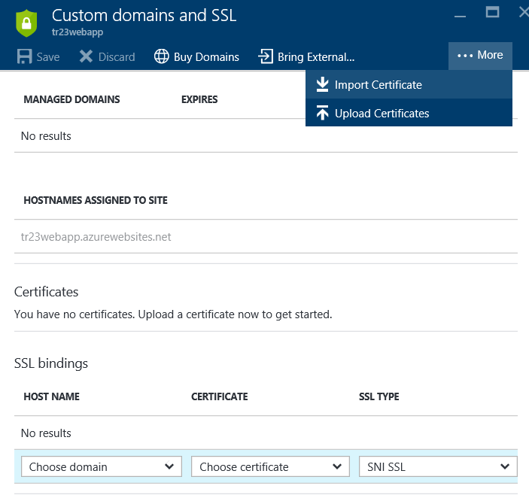
Configure WebApps
SSL
Basic or Standard mode only
Upload SSL certs for custom domain names
Custom Domain Names
Requires Shared, Basic or Standard modes!
Reserve Domain Name
Create DNS record to map DNS to Azure Web App
Add Domain Name in Azure Portal
Can map subdomains to different web apps
Monitoring
Only Basic or Standard modes
HTTP/S endpoints > 3 geo-distributed locations

Slide 17
PowerShell AzureRMWebApp*
Verbs | Nouns
Edit | BackupConfiguration
Get | Backup, Metrics, Slot, SSL Binding
New | Backup, Slot, SSL Binding
Remove | Backup, Slot, SSL Binding
Reset | PublishingProfile, SlotPublishingProfile
Restart | Slot
Restore | Backup
Set | Slot, SlotConfigName,
Start | Slot
Stop | Slot
See ALL Azure Website cmdlets

Slide 18
Manage WebApps | Xplat-CLI
To list the commands available for Azure WebApps in the xplat-cli, call azure site –h
Azure site create MSIgnite2016 –location East US
Azure site list
azure site list siteslotstest
azure site create siteslotstest --slot staging
azure site create --git siteslotstest --slot staging
azure site swap siteslotstest
azure site delete siteslotstest --slot staging
See more
See Use the Azure CLI for Mac, Linux, and Windows with Azure Resource Manager

Slide 19
Implement WebApps – know these 5 things now
Run Web Jobs 3 ways
1. Continuous 2. Schedule 3. On-Demand
Connection Strings | how made available? .Net vs. others?
.Net: uses connectionStrings | all OTHERS as Environment Variables
Website Diagnostics | # endpoints & # geo locations
Up to 2 Endpoints, 3 Geographic locations
Configure Scale –what additional options w/ STD?
Schedule : Day/ Night, Weekday/Weekend, Half hour incr. | By Metric : Instance Count, Target CPU
Hosting Plans – Name the 4
Free | Shared | Basic | Standard

Slide 20

Implement Virtual Machines
Deploy
Configure
Diagnostics, Monitoring
Scale and Resilience
App Service Plans
aka.ms/Azure/VM
compare

Slide 21

Deploy Workloads on Azure VMs
Application Frameworks
Deploy with ARM Templates see
Use Azure Portal by reference URL of template
Azure PowerShell
New-AzureRmResourceGroup -Name {resource-group-name} -Location {location}
AzureRmResourceGroupDeployment -Name {deployment-name} -ResourceGroupName {resource-group-name} -TemplateUri "https://raw.githubusercontent.com/azure/azure-quickstart-templates/master/{template-name}/azuredeploy.json"
Azure CLI
azure group create {resource-group-name} {location}
azure group deployment create --template-uri https://raw.githubusercontent.com/azure/azure-quickstart-templates/master/{template-name}/azuredeploy.json {resource-group-name} {deployment-name}
SQL Server Always On & SharePoint

Slide 22
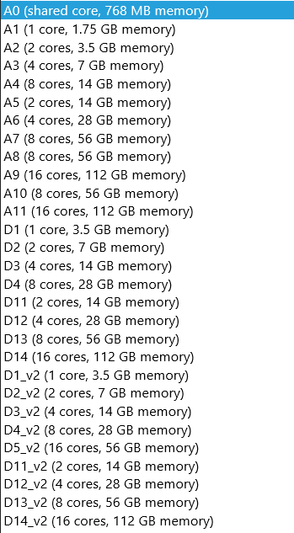
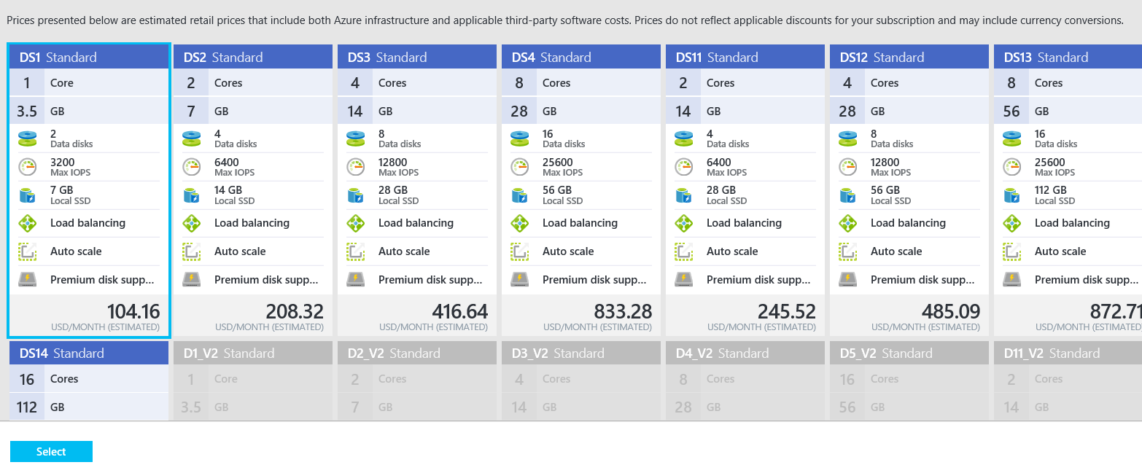
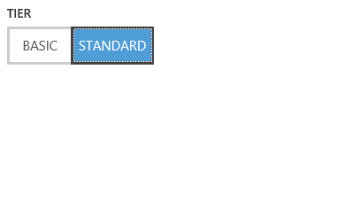
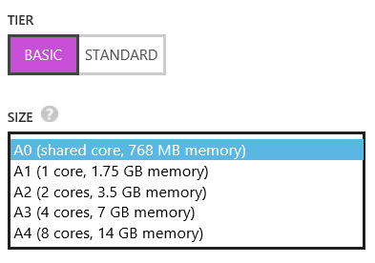
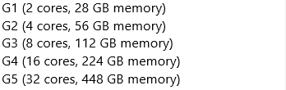
Virtual Machine Sizes
Compute Instance Name | Virtual Cores | RAM
Extra Small (A0) | Shared | 768 MB
Small (A1) | 1 | 1.75 GB
Medium (A2) | 2 | 3.5 GB
Large (A3) | 4 | 7 GB
Extra Large (A4) | 8 | 14 GB
General Purpose VMs
Compute Instance Name | Virtual Cores | RAM
A5 | 2 | 14 GB
A6 | 4 | 28 GB
A7 | 8 | 56 GB
Memory Intensive VMs
Compute Intensive VMs
Compute Instance Name | Virtual Cores | RAM | Networking
A8 | 8 | 56 GB | 40 Gbit/s InfiniBand
A9 | 16 | 112 GB | 40 Gbit/s InfiniBand
Each Persistent Data Disk Can be up to 1 TB with up to 16 disks per VM
http://azure.microsoft.com/en-us/pricing/details/virtual-machines/

Slide 23
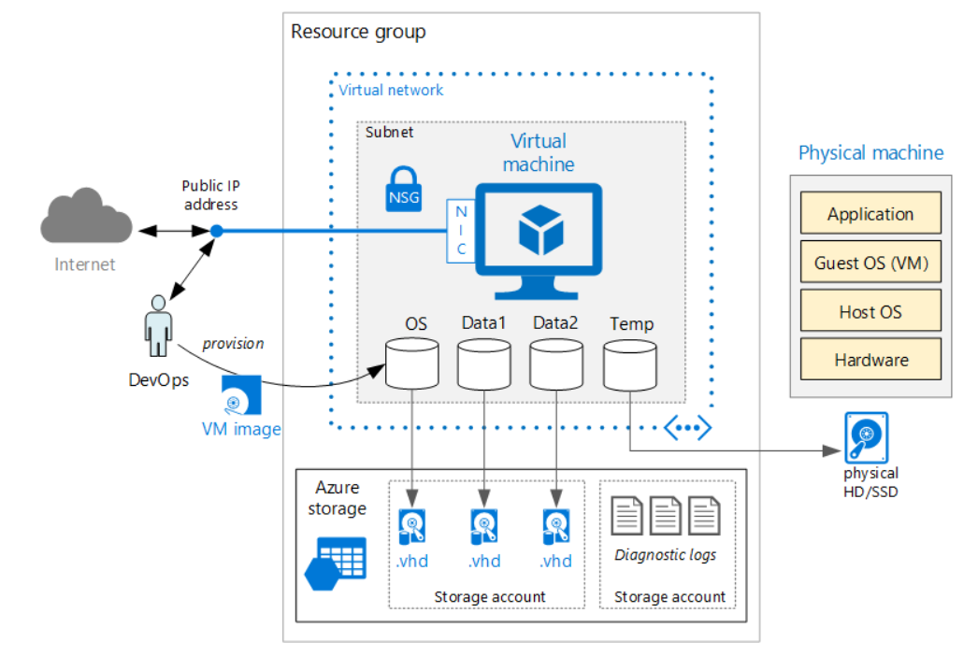
Deploy and Connect to Linux VM
Portal
Secure with SSH public key
Create or Select Resource Group
Select VM Size, Storage
Consider OS Patching VM Extension
RBAC for DevOps
See Best Practices
Azure CLI see more
Version 0.90 or greater
Switch to ARM mode azure config mode arm
Quick Test and Setup with azure vm quick-create
Can use Parameters and Template also
Custom VM Image possible
Prepare and Upload the Image
Create a VM running Windows. Create a VM running Linux

Slide 24
Create and Upload Custom VHDs
Windows Server
Sysprep VHD – OOBE and “Generalized”
Create Storage Account and Container
Upload VHD file | local source file > blob storage URL
Add Image to Custom images list… Add-AzureVMImage
Can now create VM with ARM Template or by command line
Linux
Must be Linux on Azure Endorsed
Create a Resource Group
Create a Storage Account
List Access Keys
Create containers with Access Keys above
Upload VHD to container – QEMU or KVM to convert to VHD
Can now create VM with ARM Template or by CLI
Read more

Slide 25
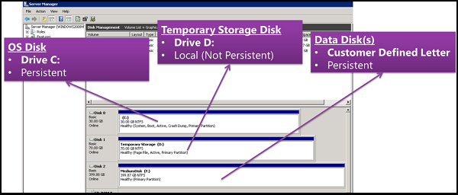
Implement Images and Disks
OS Images
Microsoft
Partner
User
Base OS image for new Virtual Machines
Sys-Prepped/Generalized/Read Only
Created by uploading or by capture
Disks (2 min)
OS Disks
Temp disks
Data Disks
Writable Disks for Virtual Machines
Created during VM creation or during upload of existing VHDs.
See About Disks and Images
See “How to Attach a Disk”

Slide 26
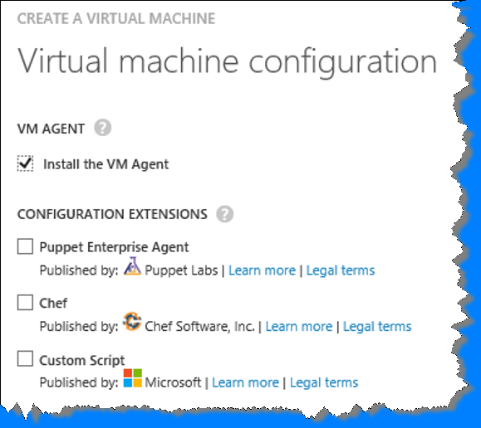
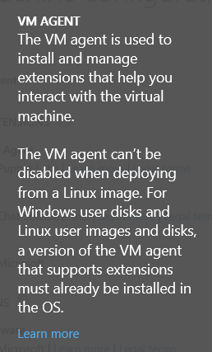
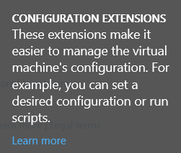
Perform Configuration Management
Automate Management
PS – Find, Create, Delete. To Automate VM Processes
DSC – w\ Azure Extension To Automate VM Config
Custom Script Exts Helper Extensions e.g.BGInfo, VMAccess, VMM
Enable Puppet Chef Extensions
Chef
Resources managed by code-based “Recipes”
Prevent configuration drift
Reusable definitions for tasks
Puppet
Build, Deploy Manage = Lifecycle
“Puppet Master” pre-configured on Ubuntu server
“Puppet Enterprise” Agent – install as agent
See “About Azure VM Configuration settings” & “Manage Images Using PowerShell”

Slide 27
Configure VM Networking
Reserved IP Addresses
10.0.0.0/8 | 172.16.0.0/12 | 192.168.0.0/16
Each can have multiple subnets
Smallest supported subnet is /29.
Size Hosts for 2^{n}-2
Set-AzureRMStaticVNetIP
Network Security Group + UDR
Apply at Subnet or NIC. At VM only in ASM
Only 1 NSG per Azure Resource, but can precreate and reuse
100 NSGs per region per subscription, 200 Rules per NSG (Only TCP or UDP)
Special Rules
Microsoft Owned IP Address of 168.63.129.16
Outbound Port 1688 reserved for Key Management Services
Read more!

Slide 28
Configure VM Networking
Load Balancing Endpoints
1 Public (used by ILB) & 1 Private Port (used by VM internally) per endpoint
Azure Balancer distributes based on: Source Address, Protocol, Source /Destination Port
Internal Load Balancing w/in Cloud Service!
Use for RDP, PSRemote, SSH
Health Probes – Load Balancers
HTTP/TCP
Allow 168.63.129.16 in any local firewall policies
Guest Agent Probes
HTTP (Only) Custom Probe for non 200ACK, e.g. 403, 404 or 500

Slide 29
Configure VM Networking
Direct Server Return
Mitigates load balancer bottleneck
vm endpoint create <VM NAME> <LB PORT> --enable-direct-server-return
Used for SQL AlwaysOn Availability (AOA) Group Listener
Port and Back End Ports MUST match!
Keep Alive
TCP Keep-Alive packets will keep the connection from your client to the load balancer open during a long-running HTTP request
.SetTcpKeepAlive(true, 30000, 30000)

Slide 30
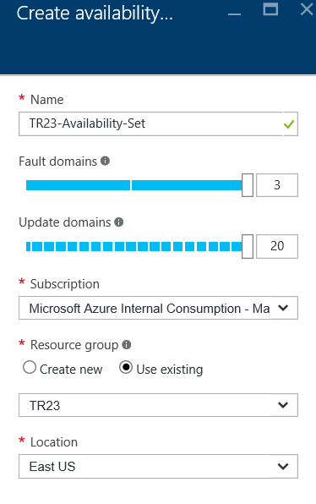
Configure VM resiliency
Configure Availability Sets
VMs in separate Fault Domains | 50 VMs Max per
SLA 99.95 | HW SW | Windows & Linux
Combine with Load Balancer to increase resiliency
Avoid Single instance machine = NO SLA
aka.ms/Azure/availability
See Azure Limits!

Slide 31
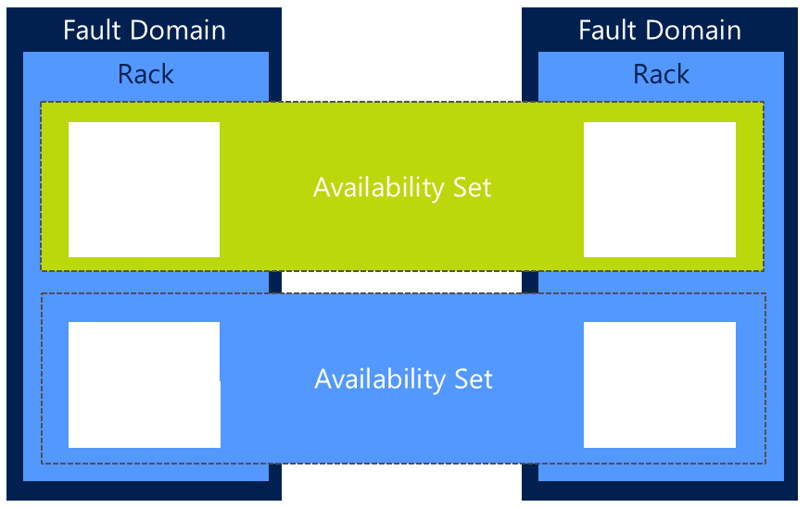
Fault and Update Domains
Fault Domains
Physical groups of resources
Same rack, Server, Power Source, Network Switch
Fabric spreads across min 2 fault domains
Availability Set spreads VMs across 3 Fault Domains
Update Domains
Logical groups of resources to be updated together
Host OS updates honour service update domains
Specified and configured in service definition
Default of 5 (up to 20)
Only 1 rebooted at a time
Fabric Controller spreads role instances across Update Domains and Fault Domains
Read more

Slide 32
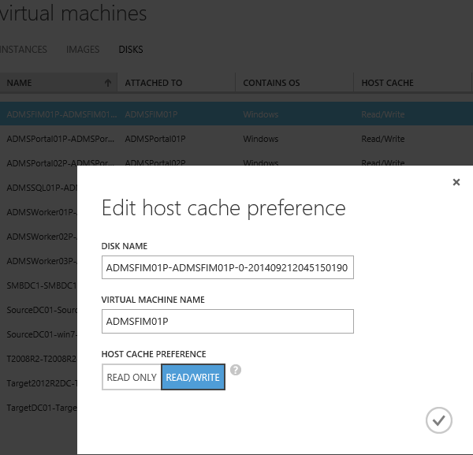
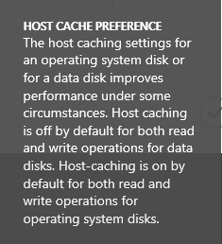
Design and implement VM storage
Configure Disk Caching
OS and Data Disk have host caching setting aka host-cache mode
Host caching - off by default for RW on data disks.
Host-caching is ON by default for RW on OS disks
PowerShell: Modify using Set-AzureRMOSDisk or Set-AzureRMDataDisk
Config OS Disk Redundancy
3 copies by default
If Geo-Redundancy enabled
Also at another site > 400 miles -> total of 6 copies

Slide 33
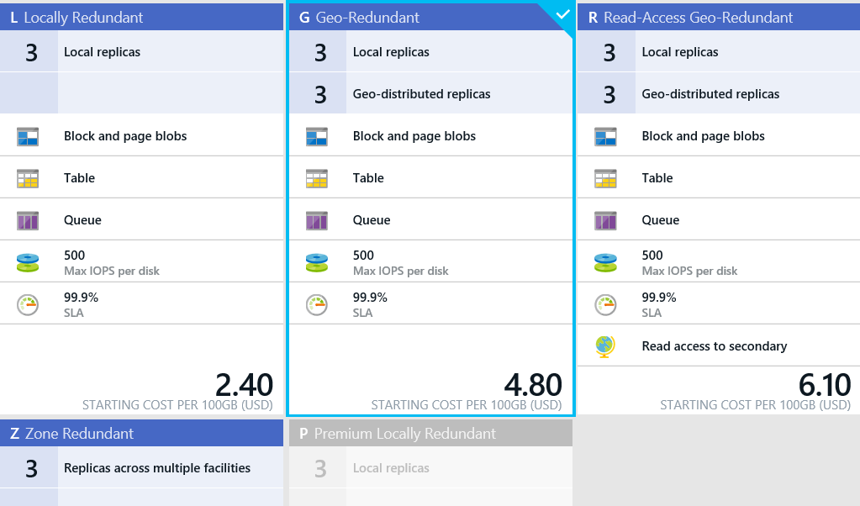
Design and implement VM storage
Config Geo-Replication
LRS – 3 local copies
ZRS – 3 copies w/in a region
GRS is recommended
over ZRS or LRS for maximum durability.
Enabled for Storage Account by default
= 6 copies of data – three times each in two data centers
RA-GRS Read-Access geo-redundant
allows read access at secondary when primary region becomes unavailable.
NOTE:
Once selected, can’t change!

Slide 34
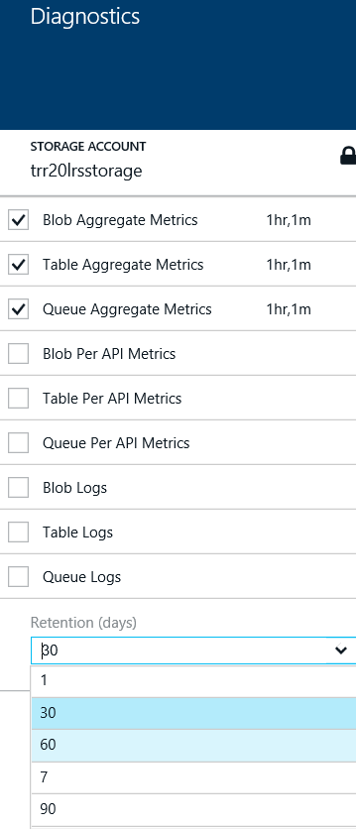
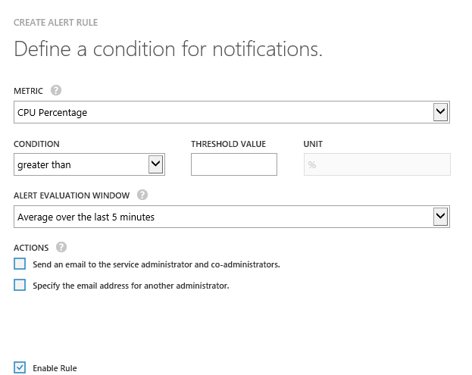
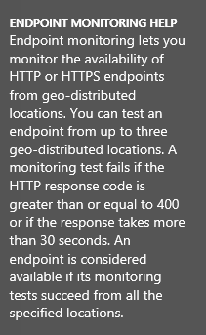
Monitor VMs
Configure Endpoint Monitoring
Can Aggregate metrics every hour or minute
Configure Alerts
Select Metric
Condition
Threshold
Alert Evaluation
Can Specify email sends
Configure Diagnostics
See monitor, diagnose and troubleshoot Microsoft Azure Storage

Slide 35
Implement Virtual Machines – know these 5 things now
3 Ways to Automate VM Management
PowerShell | Desired State Configuration | Extensions e.g. Custom, Puppet, Chef, Octopus
Load Balancing Endpoints
1 Public 1 Private IP | w/in Cloud Service | Use for RDP, PS Remote, SSH
Access Control Lists
Security Enhancement | Permit/Deny | Per Endpoint Only | By PowerShell or Mgt Portal
Fault Domain | Update Domain
Protects against rack failure | OS Updates
Geo-Replication Options
LRS (Single Region) | ZRS (Across 2-3 facilities within or across 2 regions) | GRS (3x’s in 2 regions)

Slide 36

Implement Cloud Services
Configure
Deploy Manage
Monitor
aka.ms/Azure/CloudServices

Slide 37
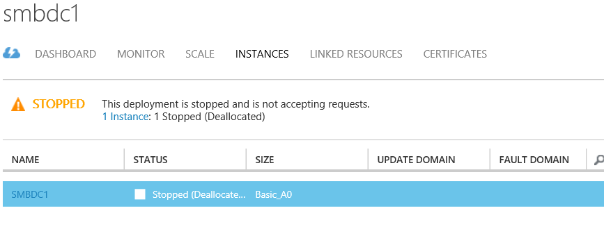

Configure cloud services and roles
Instance Count and Size
Size Determines cores & memory
OS Ver and Family
Windows or Linux
2 types of roles: by default Azure spins up 1 VM per…
web role: dedicated IIS for hosting front-end web applications
worker role: Applications can run asynchronous, long-running or perpetual tasks independent of user interaction or input.

Slide 38
Configure cloud services and roles
Configure Multiple WebApps
Configure Custom Domains
Create CNAME at Registrar
map new name to app.cloudapp.net
Auto-Scale
Manual or Automatic
By CPU, disk or network load
Also based on message queue or metric of some other resource in subscription

Slide 39
Deploy and manage cloud services
Before you begin….
Install Azure SDK, then download the SDK for the language to develop your code.
If any role instances require a certificate, create the certificates. Cloud services require a .pfx file with a private key. Upload to Azure as you create and deploy the cloud service

Slide 40
Deploy and manage cloud services
3 components are required in order to deploy an application as a cloud service in Azure:
service definition file The cloud service definition file (.csdef) defines the service model, including the number of roles. Can set Remote Access too.
Can add Startup Tasks: install a component, register COM components, set reg keys, start long running processes
Stores information regarding diagnostics logging
service configuration file The cloud service configuration file (.cscfg)
# of Role Instances
NetworkConfiguration element
service package The service package (.cspkg) contains the application code and the service definition file. Use CSPack.exe installed with Azure SDK
Requires Azure SDK
Read more even more in-depth here!

Slide 41
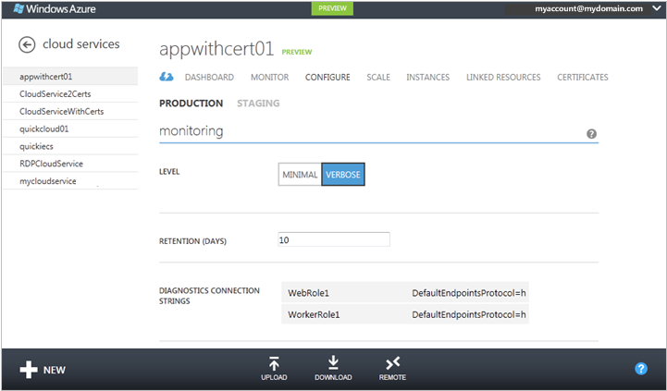
Monitor cloud services
1st Create Storage Account
Holds tables and blob for diagnostics logging
Enable Azure Diagnostics
Azure Extensions to
Collect diagnostic telemetry data from
Worker role, Web Role, or VM in Azure
Need connection strings to Storage Accounts
Then, can do verbose – stored for 10 days
Monitor Cloud Services

Slide 42
Implement Cloud Services – know these 5 things now
What is a Web Role
dedicated IIS for hosting front-end web apps
3 Components to deploy application in Azure Cloud Service?
Service Definition file (.csdef) | Service Config File (.cscfg) | Service Package (.cspkg)
What is a Worker Role
Apps run asynch, long-running or perpetual tasks independent of user interaction or input.
Diagnostics can collect from…
Worker Role | Web Role | VM’s in Azure | All from TELEMETRY Data
What are the 2 types of Service Bus Messaging capabilities?
Relayed | Brokered

Slide 43

Implement Storage
Blobs & Azure Files
Manage Access
Diagnostics, Monitoring, Analytics
Implement SQL Databases
Implement Recovery Services

Slide 44
Implement Blobs
Highly scalable, REST interface based object store in the cloud
Data sharing – share documents, pictures, video, music, etc.
Big Data – store raw data/logs and compute/map reduce over data
Backups – data and device backups
Block blobs - (read/write/update blocks of data, great for sequential IO like files). Up to 200GB each. Most cost effective storage.
Page Blobs - (read and write in 512 byte pages, sparse files and random access, e.g. for disks). Up to 1TB each
AZCopy cli high-performance uploading, downloading, and copying data to and from Microsoft Azure Blob, File, and Table storage.
FORMAT = https://{storage account}.blob.core.windows.net{blob container} KNOW /Pattern,Source,Dest

Slide 45
Azure Files
Shared Network File Storage for Azure
Availability, durability, scalability are managed automatically
Supports two interfaces: SMB and REST
aka.ms/Azure/Files
IaaS VM
IaaS VM
IaaS VM
PaaS VM
Azure File Share
(PaaS)

Slide 46
Azure Files - SMB 3.0/2.1 Protocol
Enables moving on-premises applications that rely on shared file storage to Azure
Azure VMs can “net use” to a share
SMB Features NOT supported
Natively supported by OS APIs, libraries, and tools
Windows (CreateFile, ReadFile, WriteFile, …)
CRTs (fopen, fread, fwrite, …)
.Net (FileStream.Read, FileStream.Write, …)
Many more
Supports standard file system semantics
Move and rename files and directories
Read-only, write through, overlapped
Change notifications

Slide 47
Storage Decision Matrix
How To Store | Why use This?
Azure Files | SMB Interface, Client Libraries and REST Lift & Shift an Application which already uses the native file system APIs to share data between it and other applications running in Azure. Store Development and Debugging Tools for use by many VMs
Azure Blobs | Client Libraries and REST Want APP to support Streaming and Random Access Scenarios Access Application Data from Anywhere
Azure Data Disks | Client Libraries and REST Lift and Shift applications that use native file system APIs to read and write data to persistent disks. Store data that is not required to be accessed from outside the virtual machine to which the disk is attached.

Slide 48
Manage Access
SAS – Shared Access Signatures
2 Types : Ad Hoc SAS & SAS controlled by Stored Access Policy
Delegated access to Storage Account Resources > Blobs, Queues, Tables
URI format with permissions and specified time | signedidentifier specifies Stored Access Policy
Client then passes the SAS to constructor or method
Stored Access Policies
Groups SASs + provide additional restrictions | up to 64 char
Greater control | Best Practice to use with SAS
5 policies per Container, queue or table. Each policy-unlimited SASs
Regenerate Keys
WHY? Increase security
Affects virtual machines, media services, and any applications dependent on the storage account. Must update all clients to use the new key.
Share Access Signatures, Pt 1 | Stored Access Policies

Slide 49
Configure diagnostics, monitoring and analytics
Configure Retention Policies
# Days (1-365) | zero = set no policy
Logging Levels
Minimal e.g. ingress/egress, availability, latency, & success %’s
Aggregated for the Blob, Table, and Queue services.
Verbose – Same as above + collects same metrics
per each storage operation in Azure Storage Service API. Enables closer analysis of issues occurring during application operations.
Off - Turns off monitoring. Existing monitoring data persisted till end of retention period.
Analyze Logs
Logs saved in blob container $logs in storage account.
Use Blob svc API to access Read more on logs!
See Monitor Storage Account

Slide 50
Implement SQL databases
Im/Export Data
Geo-Restore & Point in Time preferred
Can use for Archiving
Can combine with Database Copy
Temp increase perf level to decrease export times
Export is in bulk | no guarantee on transactional consistency
Export = BACPAC files | requires Storage Account | Use Export Data-tier Application Wizard
Can Schedule Automated Exports & Also Can Import/Export using REST API
Im/Export Schema
A DAC package vs BACPAC target different scenarios.
A BACPAC contains both schema and data, but does not support being imported to a database project for schema modification. DAC packages contain only schema information import into an SSDT database project for further development work. The primary use for a DAC package is in deploying a database schema to development, testing, and then production environments.
Read More

Slide 51
Implement Azure Recovery Services
Create Backup Vault
Backs up files/data from Win Server to Azure
Create a backup vault in geographic region
Vault Credentials Replace Certificates
Backup & Restore Data
“Protected Items” = been backed up
Recover 2012 or 2008 R2 SP1
Alternate Server Recovery
Know thy Passphrase used to encrypt original
New server to recover does not need to be same DNS/NetBIOS name
Start-OBRecovery -RecoverableItem $FinalItem -RecoveryOption $secureString -Credential $cstrial
See Configure Azure Back Up to back up Windows Server
Also Azure Backup Overview

Slide 52
Implement recovery services
Deploy Backup Agent
REQUIRES: WIF and PS
WABInstaller.exe
Can install on:
Servers: 2012 R2, 2012, 2008 R2 SP1
64 bit Win 7, 8, 8.1
Ext available for Server 2012 Essentials
If using DPM, requires Update Roll up 2 for SCDPM SP1
Recovery Services –> Quick Start –> to generate and download credential
Select Agent Type:
Azure Backup Agent
Windows Server and System Center Data Protection Manager
Windows Server Essentials
See Install Backup Agent and upload vault credential
Also Administer Azure Backup with Windows PowerShell

Slide 53
Implement Storage – know these 5 things now
Implement Blobs
Block Blobs (Sequential IO) up to 200GB each | Page Blobs (Random Access) up to 1 TB
Shared Access Storage
Delegated Access | Limit Permissions to Blobs, Queues, Tables | URI format w\perms & spec. time
Logging Levels
For Blobs, Tables and Queue Services | Off , Minimal, Verbose - > per Storage operations
SQL Import/Export | 2 File Types & Scenarios
BACPAC contains both schema and data | DAC packages contain only schema
Deploy Backup Agent | can install on….
Servers 2012 R2, 2012, 2008 R2 SP1, 64 bit Win 7, 8, 8.1, Ext available - Server 2012 Essentials

Slide 54

Implement Azure Active Directory
Directory Integration
App Access Panel
Application Integration
aka.ms/Azure/AD

Slide 55
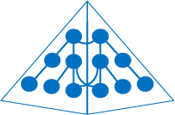

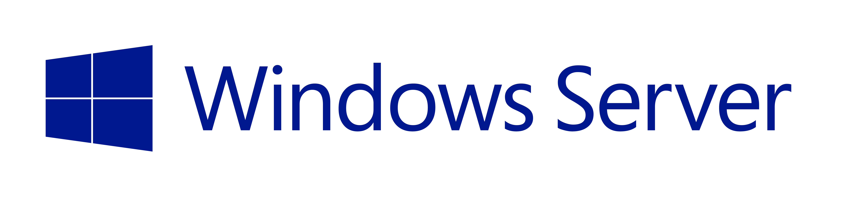
Integrate an Azure AD with existing directories
Synchronization
Active Directory
Active Directory
Identity Sync with password hash sync
User attributes are synchronized including the password hash, Authentication can be completed against either Azure or Windows Server Active Directory
*Write back of attributes to support cloud first and co-existence
Federation
Identity Sync
Active Directory
Active Directory
AD FS provides conditional access to resources, Work Place Join for device registration and integrated Multi-Factor Authentication
User attributes are synchronized, Authentication is passed back through federation and completed against Windows Server Active Directory
AD FS

Slide 56
Configure the Application Access Panel
Configure SaaS SSO
SaaS providers leverage AAD as an IdP STS.
This is similar to the relationship they would otherwise have with AD FS
AAD decides how to authenticate the user:
Federated or standard
MFA
simple password
SSO is facilitated using the protocols expected by the SaaS provider:
SAML-P, WS-Federation, OpenID Connect
Depending on the app, single-sign out and password reset integration will be supported

Slide 57
Configure the Application Access Panel
Add Users/Groups to Apps
Access Panel by http://myapps.microsoft.com
Custom branding? Load by appending your organization’s domain
http://myapps.microsoft.com/contosobuild.com
USERS CAN:
change PW, Edit PW Reset, MFA prefs, view account details, view/launch apps
Self-manage groups
Authentication
Users must be authenticated by Organizational account in AAD
If Federation, then can AuthN against on-premises
Read more…

Slide 58
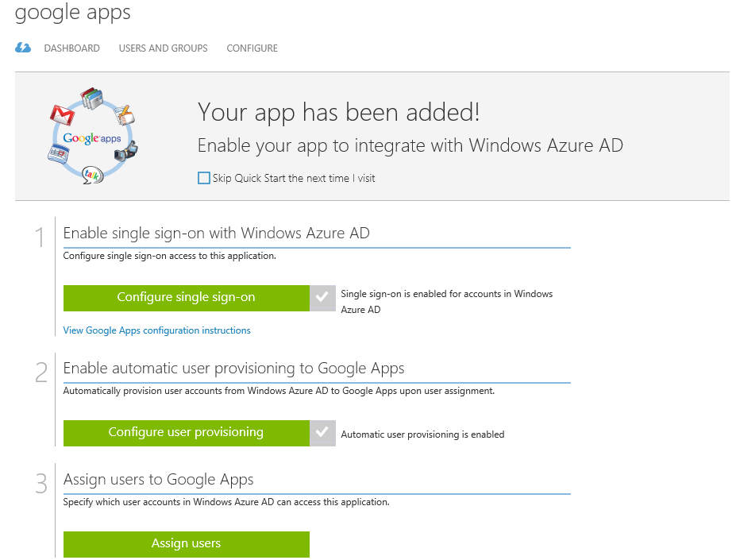
Configure the Application Access Panel
Read more
Read more – Adding apps

Slide 59
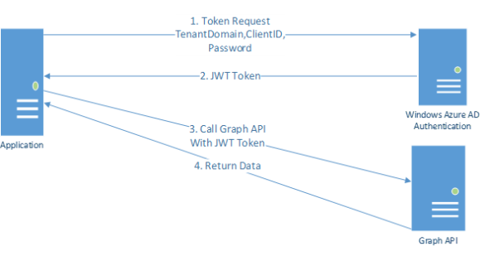
Integrate an app with Azure AD
Web Apps | WS-Fed
SOAP Clients | WS-Trust spec | RST/RSTR
Desktop Apps | OAuth
RESTful Apps | HTTP Methods | Stateless
Graph API
Programmatic access to AAD through REST API Endpoint
Apps use to perform CRUD operations on Directory data and objects
To call on directory must register APP with AAD
RBAC – Security Groups used to perform RBAC in Graph API
EXAMPLES
Create New User, Get Properties, Disable
Check Group Membership, update, delete, etc
Query an Azure AD directory using the Graph API

Slide 60
Implement Azure Active Directory – know these 5 things now
Azure AD Integration Options
Azure AD Sync | FIM 2012 R2
Add Custom Domains
Create CNAME | Get-AzureRMDeployment -ServiceName yourservicename | Select Url
Configure SaaS SSO
AAD is the IdP | AAD determines AuthN, fed/std/MFA/Password, SSO: SAML-P, WS-Fed, Open ID Connect
WS-Fed vs. Oauth Apps
SOAP Clients, WS-Trust spec, RST/RSTR | RESTful Apps, HTTP Methods, Stateless
Graph API
Access AAD | REST | CRUD operations | Must register App with AAD | Security Groups use RBAC

Slide 61

Implement Virtual Networks
Configure Virtual Network
Modify Network Configuration
Design/Implement Multi-Site/Hybrid Network

Slide 62



Implement Virtual Networks
Virtual Networks
Flexible, multi-tier topology
Network segmentation
Internal load balancing
Azure
Virtual Network
Service consumers
Internet
Front-End Network Access
Load-balanced and direct VIPs
ACLs & DDoS protection
Traffic Manager & Azure DNS
Hybrid Connectivity
Secure Internet cross premises VPN connectivity
ExpressRoute – direct connectivity
On premises Datacenter

Slide 63

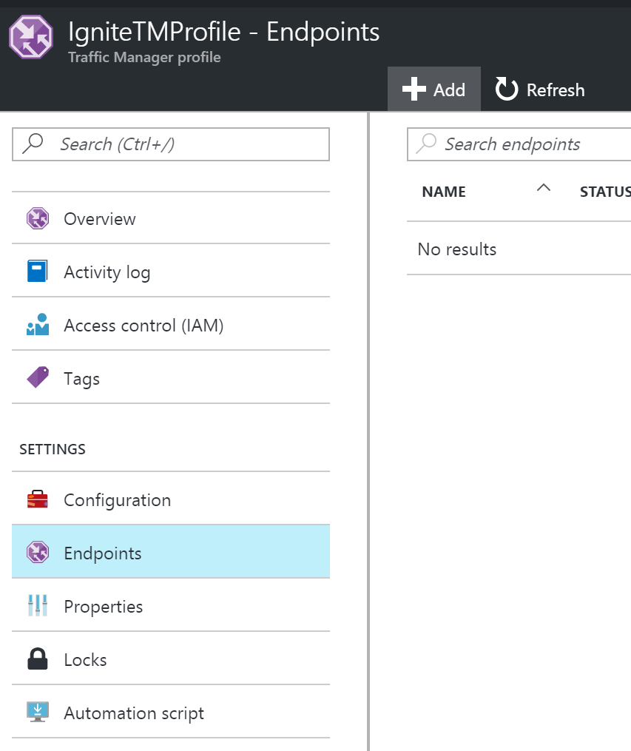
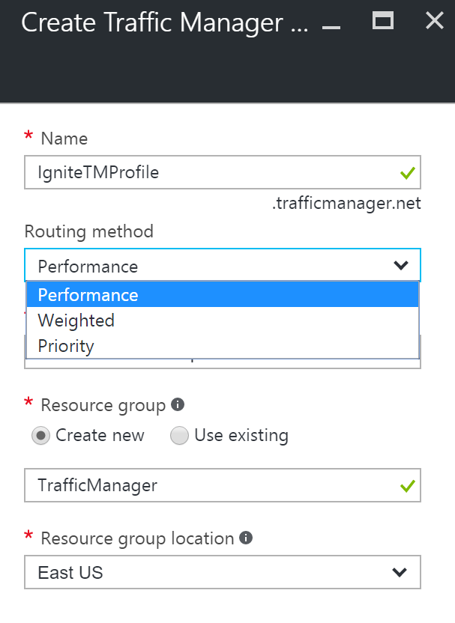
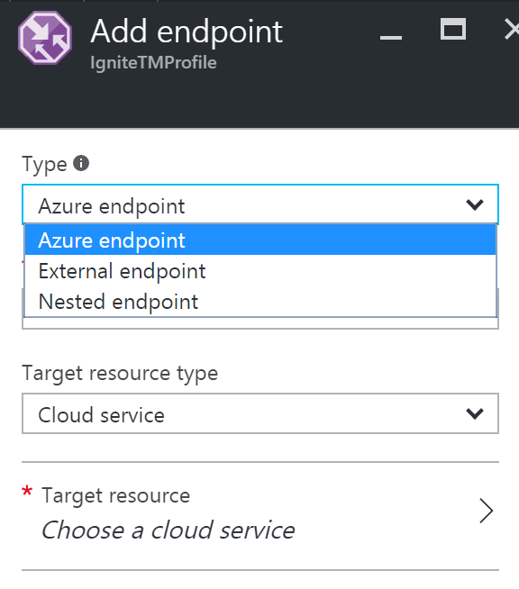
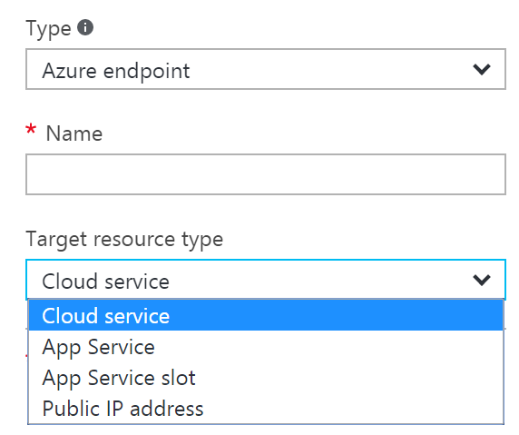

Traffic Manager: DNS-based Load Balancing
www.yourapp.com
Load balancing policies
Performance - Direct to “closest” service based on network latency
Round-robin - Distribute equally across all services
Failover - Direct to “backup” service if primary fails —also included in other policies

Slide 64
Internet IP Addresses & Load Balancing
Public IP Addresses
Connect with Internet and Azure Public facing services
Can assign to VM, Internet LBs, VPN Gateways, Application Gateways
Dynamic (default) or Static
Assign to NIC on Windows or Linux
Private IP Addresses
Communicate over VPN or through Gateway or Express Route
Not internet reachable address
Apply to VM, GWs or Application Gateways
aka.ms/Azure/Addresses

Slide 65


Azure Virtual Network
On Premises
10.0/16
Bring Your Own Network
Address spaces – Private/RFC1918 & Public IP*
Multi-tier subnet topology
Bring your own AD & DNS
Linux, virtual appliances, & Windows
Logical isolation using Network Security Groups
Secure cross premises connectivity
Internet
S2S VPNs &
ExpressRoute
Direct Internet
Connectivity
VPN GW
Backend
10.3/16
Mid-tier
10.2/16
Frontend
10.1/16
AD / DNS
Azure Virtual Network

Slide 66
Internal Load Balancing
Enables load balancing among VMs with private IP addresses
Accessible only by customer’s virtual network and on-premises networks
Multi-tier applications with internal facing tiers require load balancing
HA LOB apps
SQL Always On
RDP to internal endpoints for added default security
Internet
Public VIP
Azure Virtual Network
External load balancer
Internal VIP
Internal
load balancer
Back end
Front end
Web frontend tier
Logic tier

Slide 67
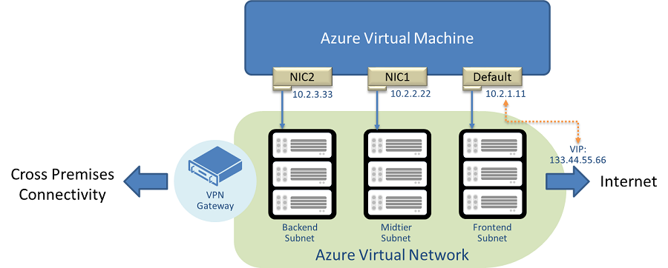
Multiple NICs in Azure VMs
Multiple NICs enable virtual appliances in Azure
IaaS (Azure VMs); VNet only
MAC/IP addresses persist through VM life cycle
No user action required
Separate frontend-backend traffic, and management-data planes
Internet

Slide 68

Configure a Virtual Network
Configure Static IPs
Verify IP Address free
Test-AzureRMStaticVNetIP –VNetName TestVNet –IPAddress 192.168.4.7
Specify when creating new VM or for existing
Can remove when done see all PS Examples!
Configure Internal Load Balancing
Create ILB Instance
Add endpoint to the ILB Instance
Configure Servers to send their traffic to the new ILB Endpoint
Existing virtual networks that have been configured for an affinity group cannot use ILB
Read More – See PowerShell Examples!

Slide 69
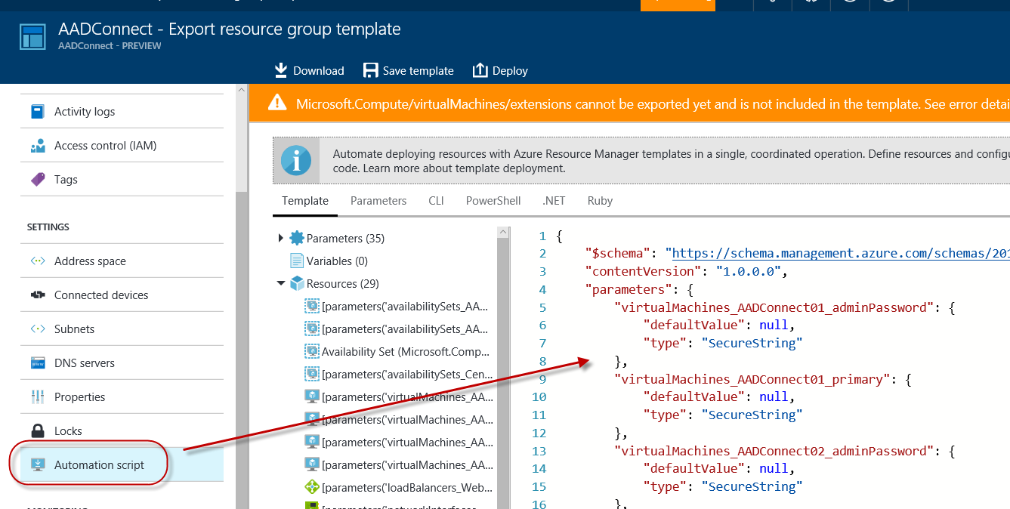
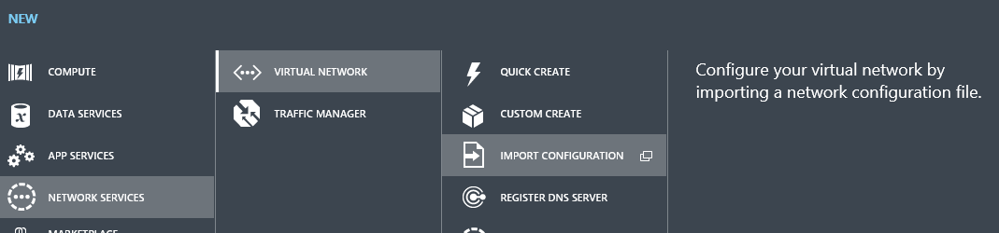
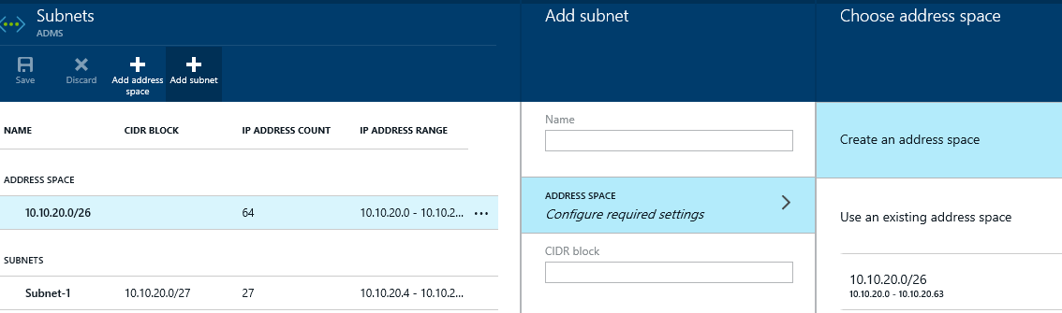
Modify a Network Configuration
Read More
Modify a Subnet
Import a Network Configuration
Export a Network Configuration

Slide 70
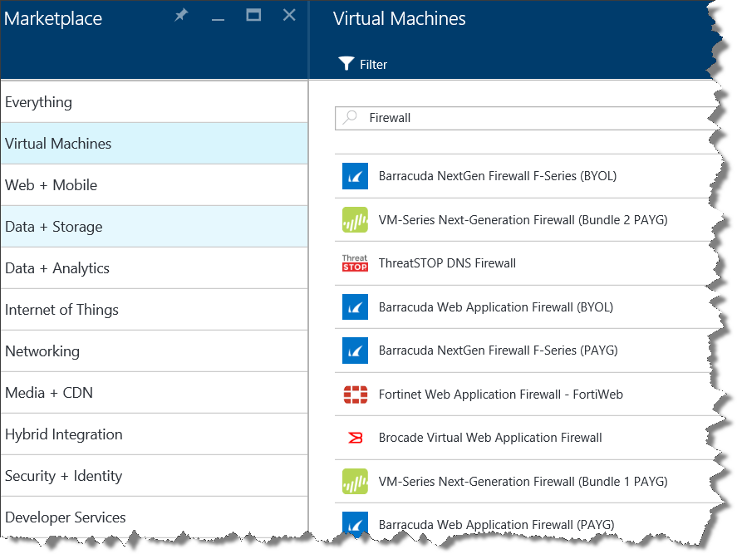
Bring Your Appliances to the Cloud
Building blocks
Multiple NICs
MAC address persistence
Appliance ecosystem
Barracuda NG Firewall
Citrix NetScaler
Riverbed Steelhead, SteelApp, SteelStore
More to come!
Azure Certified
”

Slide 71
Gateway Enhancements
High Performance Gateway
Better throughput
More S2S tunnels
Pricing
$0.49 per gateway hour
Data transfer & VNet traffic rates unchanged
No Encryption option
Better throughput for Vnet-to-Vnet within Azure
Intra-/Inter-region Vnet-to-Vnet traffic stays within Microsoft networks, not Internet
PFS Support for IKE
Compliance requirements & better security
Operations Logs
Visibility into critical gateway events
Gateway SKU | ExpressRoute Throughput* | S2S Throughput* | Max Tunnels
Default | 500 Mbps | 100 Mbps | 10
Performance | 1000 Mbps | 200 Mbps | 30
* Subject to traffic conditions and application behavior

Slide 72
Implement Virtual Networks – know these 5 things now
Network Security Groups
Used for NIC (ARM), VM (ASM Only) & Subnets (ASM/ARM) | Create with PowerShell, CLI, Rest API
Create ILB with PowerShell
Add-AzureRMInternalLoadBalancer
Import Network Config | Modify Subnets
In the new portal, use an ARM Template. Can export it from an existing one also!
Easiest method to connect On-premises network
Site-Site
Express Route
Just do it! Or else watch some videos!

Slide 73
In review: session objectives and takeaways
Q&A

